Slide 1

Objectives
In this session, you will learn to:
  Explain the integration of business processes using ERP
  Define products and services
Notes:
Use this slide to explain the objective of the session to the students.

Slide 2

Introduction to ERP Modules
Do you remember, ERP module is one of the components of ERP package.
Notes:
Use this and the following slides to explain the ERP modules and its features.

Slide 3

Introduction to ERP Modules (Contd.)
Let’s discuss more about ERP modules.
Notes:
Use this and the following slides to explain the ERP modules and its features.

Slide 4
Introduction to ERP Modules (Contd.)
An ERP module implements one or more related business processes.
Each module is divided into subsystems that automate these business processes.
Each subsystem supports multiple features that automate one or more steps of the business process.
Notes:
Use this and the following slides to explain the ERP modules and its features.

Slide 5
Introduction to ERP Modules (Contd.)
The ERP package provides the following modules:
  Finance
  Human Resource
  Sales
  Materials Management
  Manufacturing
  Quality Management
Notes:
Use this and the following slides to explain the ERP modules and its features.

Slide 6
Introduction to ERP Modules (Contd.)
Finance module:
  Helps in controlling and managing the financial and cost accounting processes of an enterprise.
  Includes functionality for asset management.
  Generates reports to facilitate information sharing.
Notes:
Use this and the following slides to explain features of financial module and its sub-systems in ERP .

Slide 7
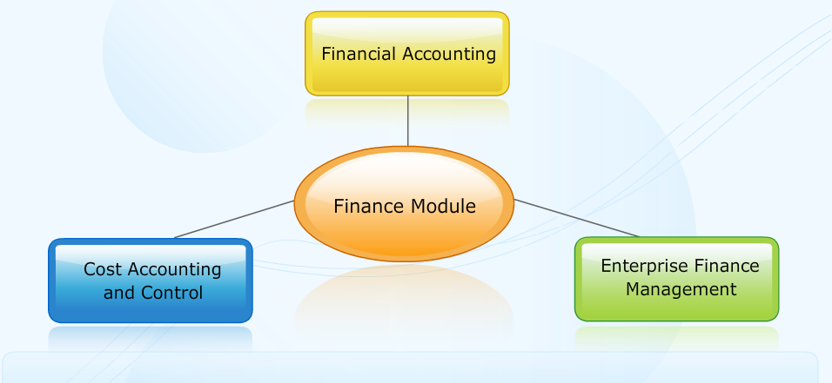
Introduction to ERP Modules (Contd.)
The following figure depicts the subsystems of the finance module.

Slide 8
Introduction to ERP Modules (Contd.)
  Financial accounting subsystem:
    Automates the generation of financial statements of an enterprise.
  Cost accounting and control subsystem:
    Automates the tracking and analysis of costs of an enterprise.
  Enterprise finance management subsystem:
    Manages and controls the capital and funds of an enterprise.

Slide 9
Introduction to ERP Modules (Contd.)
Human resource module:
  Is used to manage employees in an enterprise.
  Automates various employee-related processes, such as payroll, training, and recruitments.
Notes:
Use this and the following slides to explain features of financial module and its sub-systems in ERP .

Slide 10
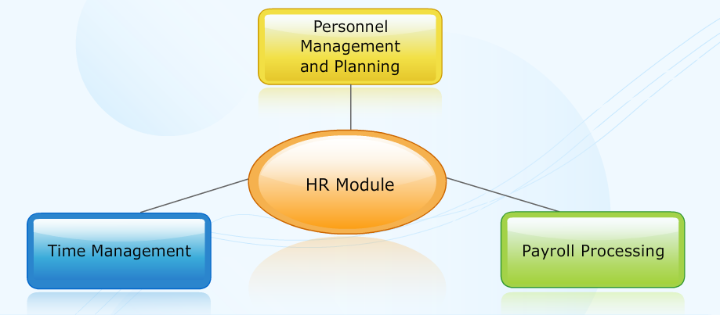
Introduction to ERP Modules (Contd.)
The following figure depicts the subsystems of the HR module.

Slide 11
Introduction to ERP Modules (Contd.)
  Personnel management and planning subsystem:
    Manages the employee information.
    Helps to plan the functions that the employees perform in the organization.
  Time management subsystem:
    Evaluates the time spent by employees.
  Payroll processing subsystem:
    Helps in integrating payroll accounting with the financial module.
Notes:
Use this and the following slides to explain features of HR module in ERP .

Slide 12
Introduction to ERP Modules (Contd.)
Sales module:
  Helps create and control sales orders.
  Automates the entry and tracking of sales order-related data.
Notes:
Use this and the following slides to explain features of financial module and its sub-systems in ERP .

Slide 13
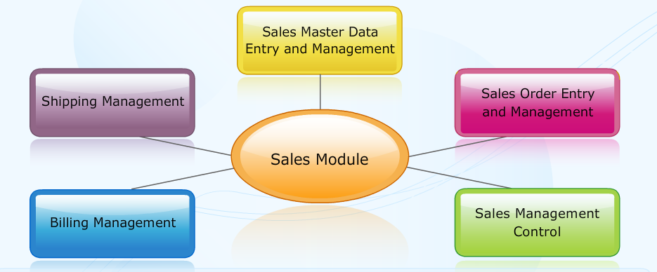
Introduction to ERP Modules (Contd.)
The following figure depicts the various subsystems of the sales module.

Slide 14
Introduction to ERP Modules (Contd.)
  Sales master data entry and management subsystem:
    Manages data regarding products, customers, and vendors.
  Sales order entry and management subsystem:
    Simplifies entry of sales orders and their posting and tracking.
  Shipping management subsystem:
    Handles the distribution of products to ensure customer satisfaction through timely delivery.
Notes:
Use this and the following slides to explain features of sales module and its sub-systems in ERP .

Slide 15
Introduction to ERP Modules (Contd.)
  Billing management subsystem:
    Covers the processes involved in planning and initiating bills for the delivered products.
  Sales management control subsystem:
    Covers pre-sales and post-sales activities.

Slide 16
Introduction to ERP Modules (Contd.)
Materials management module:
  Is used to manage purchases and inventory.
  Automates the processes of purchase, storage, and usage of raw materials.
Notes:
Use this and the following slides to explain features of financial module and its sub-systems in ERP .

Slide 17
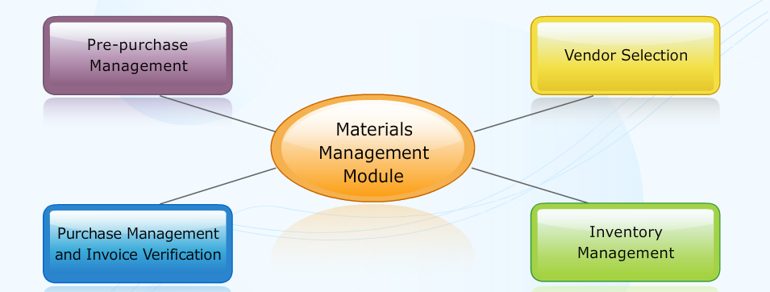
Introduction to ERP Modules (Contd.)
The following figure depicts the various subsystems of the materials management module.

Slide 18
Introduction to ERP Modules (Contd.)
  Pre-purchase management subsystem:
    Handles the activities performed before the actual procurement of material or services.
  Vendor selection subsystem:
    Selects contracted vendors to supply services or material for a particular requisition.
Notes:
Use this and the following slides to explain features of material management module and its sub-systems in ERP .

Slide 19
Introduction to ERP Modules (Contd.)
  Purchase management and invoice verification subsystem:
    Handles the procurement of material or services.
  Inventory management subsystem:
    Handles inventory control.

Slide 20
Introduction to ERP Modules (Contd.)
Manufacturing module:
  Helps accept production orders and plans, and processes them up to delivery.
  Integrates with the Sales and Materials Management modules to automate processes.
Notes:
Use this and the following slides to explain features of manufacturing module and its sub-systems in ERP .

Slide 21
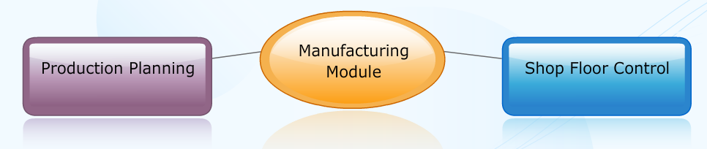
Introduction to ERP Modules (Contd.)
The following figure depicts the various subsystems of the manufacturing module.

Slide 22
Introduction to ERP Modules (Contd.)
  Production planning subsystem:
    Helps plan and schedule production to ensure quality delivery on time.
  Shop floor control subsystem:
    Facilitates effective management of the shop floor.

Slide 23
Introduction to ERP Modules (Contd.)
Quality management module:
  Controls the quality of products based on industry standards such as ISO 9001.
  Automates the process at each step of the product development lifecycle.
Notes:
Use this and the following slides to explain features of manufacturing module and its sub-systems in ERP .

Slide 24
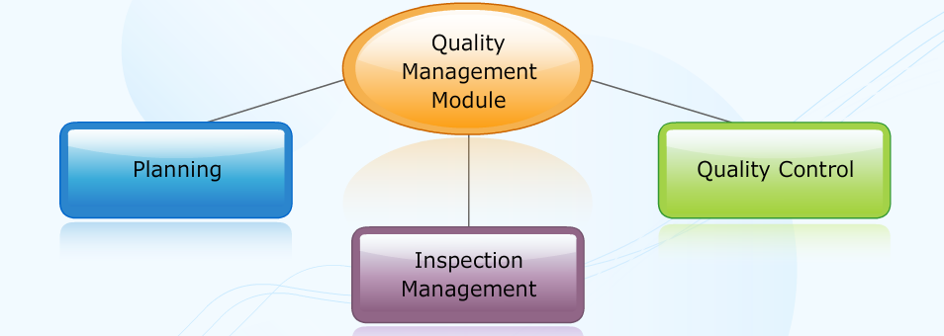
Introduction to ERP Modules (Contd.)
The following figure depicts the various subsystems of quality management module.

Slide 25
Introduction to ERP Modules (Contd.)
  Planning subsystem:
    Helps plan the quality inspection process in an enterprise.
  Inspection management subsystem:
    Facilitates inspection of goods manufactured.
  Quality control subsystem:
    Helps in maintaining the quality of all business processes, products, or services in an enterprise.
Notes:
Use this and the following slides to explain features of Quality module and its sub-systems in ERP .

Slide 26
Introduction to ERP Modules (Contd.)
Problem Statement 3.1:
  Peter’s organization has recently set up an ERP system and is in the process of training its employees on the system. Peter is one of the trainers. He has been asked to train the contract management department of her enterprise for using the ERP system.
Task:
  Which subsystem of the Sales module should Peter train the contract management team on?
Notes:
Discuss the Problem Statement 3.1 with the students.
Solution
Sales management control

Slide 27
Integration of ERP Modules
In the previous session, we discussed various ERP modules.
Notes:
Use this and the following slides to explain the ERP modules and its features.

Slide 28
Integration of ERP Modules (Contd.)
Now, let’s discuss the integration of ERP modules.
Notes:
Use this and the following slides to explain the ERP modules and its features.

Slide 29
Integration of ERP Modules (Contd.)
Integration of modules enables information sharing between them.
This helps increase the productivity of departments and profitability of the enterprise.

Slide 30
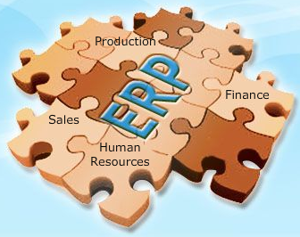
Integration of ERP Modules (Contd.)
The following figure displays the integration of various ERP package modules.

Slide 31
Integration of ERP Modules (Contd.)
The integration of various modules:
  Integration between Sales and Finance modules
  Integration between HR and Finance modules
  Integration between Materials Management, Sales, and Quality Management modules
  Integration between Materials Management, Sales, and Production modules

Slide 32
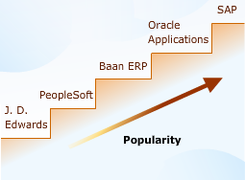
ERP Package Market
The ERP packages' market has grown considerably over the last decade.
The following figure shows the five popular and established ERP vendors in the world.

Slide 33
Defining Product Standards
Now, let’s discuss the product standards.
Notes:
Use this and the following slides to explain the ERP modules and its features.

Slide 34
Defining Product Standards (Contd.)
The customer needs quality product or service to maintain a sustained relationship with the vendor.
Therefore, it is important to understand the criteria for a quality product and service.
Notes:
Use this and the following slides to explain about product and services and the product lifecycle.
Explain to the students that ‘Marketing’ differs from ‘Selling’. Marketing involves all the activities of listening to customer needs, assessing the competitive landscape and then designing and creating products and services accompanied by messages that shape audience perceptions, leading to opportunities for revenue. The primary objective of marketing is to deliver products and services to the right audience at the right price and right time, thereby increasing brand loyalty
Defining Product Standards
Focus on how formulating sales strategies can help business processes achieve their end-objectives.
Offline services include:
After the sale of a product such as vacuum cleaner or water purifier, the company salesperson pays regular visits to the customer to verify that the product is working perfectly.
For the sale o f a computer system, if the customer wants additional software, the vendor along with providing the software, sends a technical person to load the software and explain the functioning of the software to the customer.
Online services include:
Telephone companies and banks provide online facilities that provide information to the customer regarding the current balance, the details of ATM transactions or even the ability perform transactions through the telephone.
Customers should always demand the receipt of the purchased product. This way the transaction becomes legally binding and can be accounted for in case transactions need to be traced for by the customer, business organization, or the government.
By not generating a receipt for any sales transaction the money involved in the transaction cannot be traced or accounted for. In such cases, both the buyer and the seller can be penalized for conducting an illegal transaction.

Slide 35
Defining Product Standards (Contd.)
A product is simply what a company offers to its customers.
The main objective of a product is to make the customer feel satisfied or benefited once the product is purchased.
Notes:
Use this and the following slides to explain about product and services and the product lifecycle.
Explain to the students that ‘Marketing’ differs from ‘Selling’. Marketing involves all the activities of listening to customer needs, assessing the competitive landscape and then designing and creating products and services accompanied by messages that shape audience perceptions, leading to opportunities for revenue. The primary objective of marketing is to deliver products and services to the right audience at the right price and right time, thereby increasing brand loyalty
Defining Product Standards
Focus on how formulating sales strategies can help business processes achieve their end-objectives.
Offline services include:
After the sale of a product such as vacuum cleaner or water purifier, the company salesperson pays regular visits to the customer to verify that the product is working perfectly.
For the sale o f a computer system, if the customer wants additional software, the vendor along with providing the software, sends a technical person to load the software and explain the functioning of the software to the customer.
Online services include:
Telephone companies and banks provide online facilities that provide information to the customer regarding the current balance, the details of ATM transactions or even the ability perform transactions through the telephone.
Customers should always demand the receipt of the purchased product. This way the transaction becomes legally binding and can be accounted for in case transactions need to be traced for by the customer, business organization, or the government.
By not generating a receipt for any sales transaction the money involved in the transaction cannot be traced or accounted for. In such cases, both the buyer and the seller can be penalized for conducting an illegal transaction.

Slide 36
Defining Product Standards (Contd.)
A good product fulfills the following key criteria:
  Meets the perceived needs of customers
  Satisfies customers
  Is reasonably priced
  Has good after-sale support
Notes:
Use this and the following slides to explain about product and services and the product lifecycle.
Explain to the students that ‘Marketing’ differs from ‘Selling’. Marketing involves all the activities of listening to customer needs, assessing the competitive landscape and then designing and creating products and services accompanied by messages that shape audience perceptions, leading to opportunities for revenue. The primary objective of marketing is to deliver products and services to the right audience at the right price and right time, thereby increasing brand loyalty
Defining Product Standards
Focus on how formulating sales strategies can help business processes achieve their end-objectives.
Offline services include:
After the sale of a product such as vacuum cleaner or water purifier, the company salesperson pays regular visits to the customer to verify that the product is working perfectly.
For the sale o f a computer system, if the customer wants additional software, the vendor along with providing the software, sends a technical person to load the software and explain the functioning of the software to the customer.
Online services include:
Telephone companies and banks provide online facilities that provide information to the customer regarding the current balance, the details of ATM transactions or even the ability perform transactions through the telephone.
Customers should always demand the receipt of the purchased product. This way the transaction becomes legally binding and can be accounted for in case transactions need to be traced for by the customer, business organization, or the government.
By not generating a receipt for any sales transaction the money involved in the transaction cannot be traced or accounted for. In such cases, both the buyer and the seller can be penalized for conducting an illegal transaction.

Slide 37
Summary
In this session, you learned that:
  ERP packages from all vendors include standard modules, such as finance, sales, and human resource.
  In addition to the standard modules, some ERP packages include specialized, industry-specific modules.
  Integration of modules enables information sharing between them. This helps increase the productivity of departments and profitability of the enterprise.
  The five popular and established ERP vendors in the world are SAP AG, Oracle, Baan, PeopleSoft, and J D Edwards.
Notes:
Use this and the following slides to summarize the key concepts of the session to the students.

